Slide 1

Guest Experiences @ X Hotel
Sreenija Kurra
From SlidesGO

Slide 2
Comparing Checkin and Check out Opinions
Delicious Breakfast
Fast and Reliable Wi-Fi
Quiet and Restful Environment
High mentions of peaceful and calm environment at the hotel during check out
Breakfast attracted over 50% of guests during booking and was praised by more than 60% after their stay
Guests benefitted from consistent Wi-Fi to work remotely and for leisure
Data-backed outcomes
Notable Findings
89%
Guests loved the quiet and restful environment
Guests expected bare minimum when they checked in to the hotel but had different views on check out
Positively affected by the existing marketing strategies by the hotel management team with reviews and visuals
Hotel offerings appealed to a diverse range of guest profiles
81%
Wi-Fi met expectations in both check-in and check-out
13
Guests didn’t mention Wi-Fi during check-in but praised it at check-out.

Slide 3
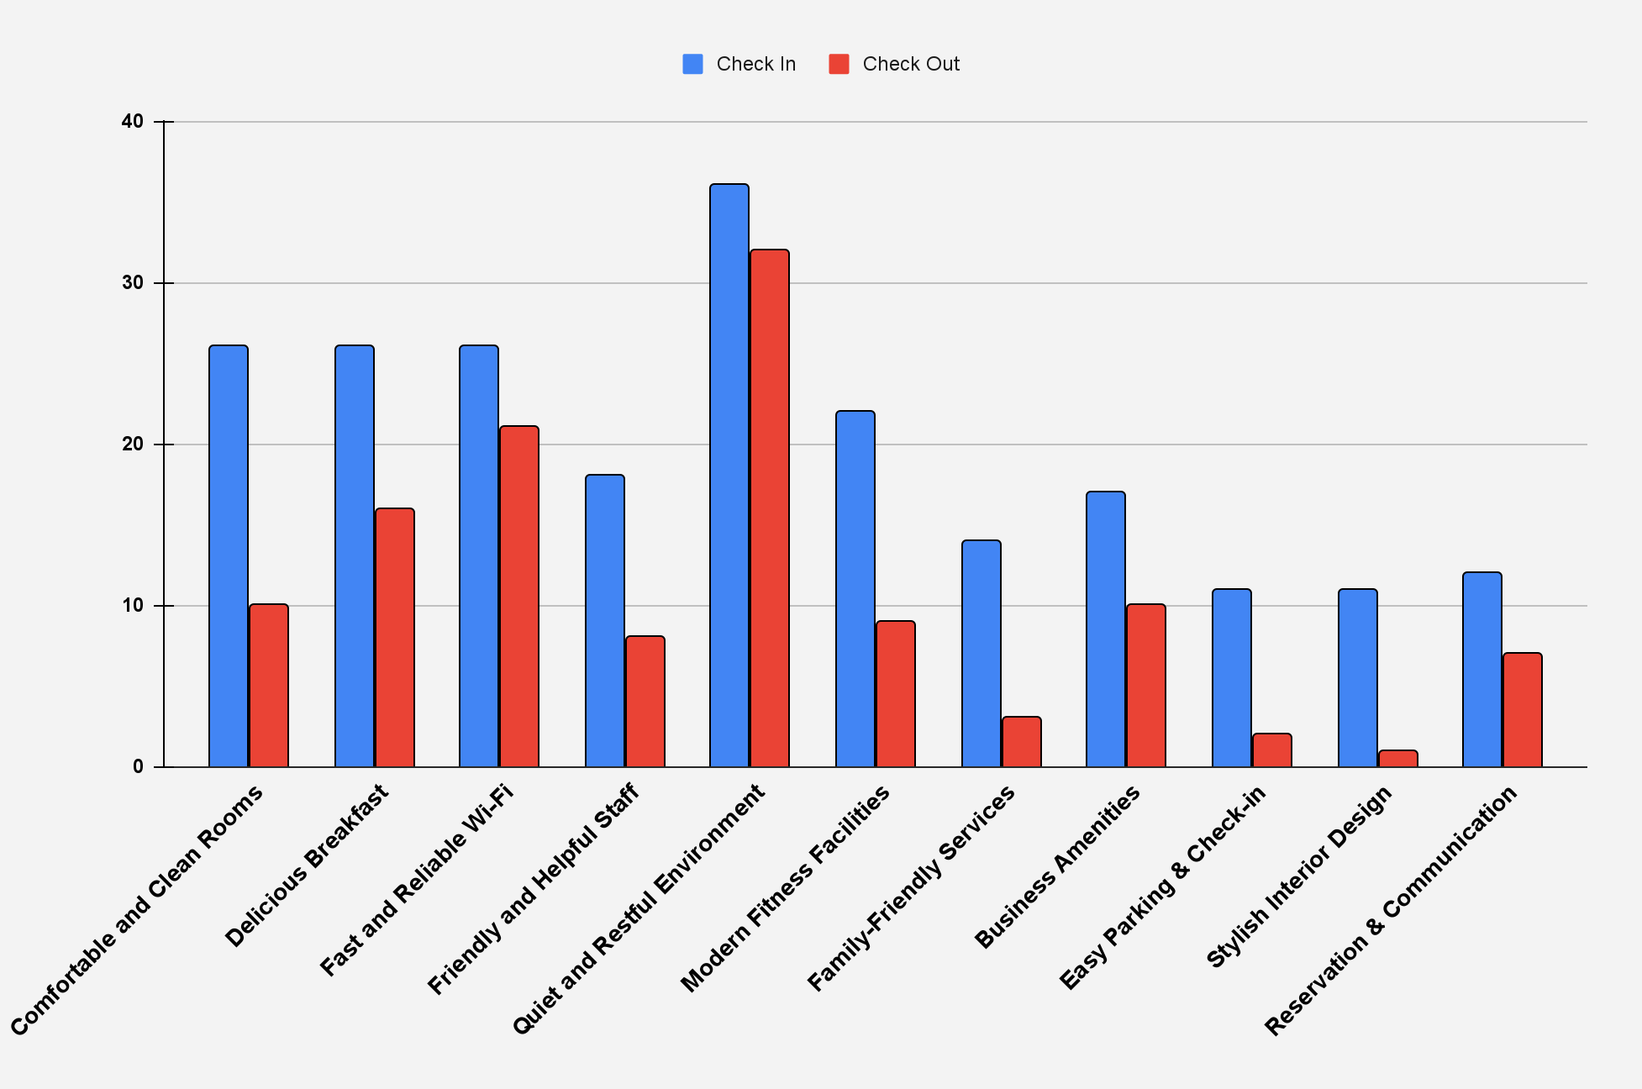
Guest Experiences
Clean & Comfortable rooms
Friendly Staff
High expectations weren’t fully met. Check-out mentions dropped sharply, pointing to inconsistency in comfort or upkeep
Service perception declined after stay. Reflects inconsistent experiences or gaps in personal interaction
Fitness Facilities
Family Friendly
Many guests expected it, few used or mentioned it after check-out. Possibly underutilized, unnoticed, or lacked appeal
Lack of engaging activities, accommodations, or active family support might explain the low check-outs
Parking and Check-In
Interior Design
Very few mentions by guests. Indicates lack of visibility in marketing or check-in experience was standard at best
Designs aren’t distinct or emotionally engaging enough to stand out

Slide 4
Recommendations
Smooth Check-in
Comfy Rooms - Prompt Service
Improve check-in flow to elevate a currently “neutral” experience
Promote undervalued features such as ease of arrival and parking in marketing for first impressions
Offer digital pre-check-in and optional concierge welcome
Invest in upkeep consistency and staff training for comfortable & clean rooms
Use technology to route and track service requests.
Empower staff to fulfill special requests with warmth and care.
Top Class Amenities
Marketing Efforts
Ensure amenities are accessible, visible, and maintained.
Offer booking options for gym or meeting spaces to promote guest satisfaction
Introduce kid zones or family perks to reinforce a welcoming environment for all ages.
Promote features that exceeded expectations post-stay (e.g., breakfast, Wi-Fi)
Reposition underappreciated amenities (e.g., interiors, check-in ease) through professional photos and more agency listings.
Use bundled experiences (e.g., “Workcation Package”, “Family Weekend”)

